Slide 1
Bazat e Marketingut
David Jobber
Kapitulli 8 Menaxhimi i produkteve
Notes:
1
1

Slide 2
Learning Objectives
The concept of product, brand, product line and product mix
The difference between manufacturer and own- label brands
The difference between a core and augmented product ( the brands)
Brand building issues
The arguments for and against global and pan- European branding
The strategic options that can be used to build pan European brands
The difference between family, individual and combined brand names and the characteristics of an effective brand name
The concept of brand extension and streching their uses and limitations
The issues involved with the product life cycle concept its uses and its limitations
The uses and limitations of product portofolio evaluation models as a means of managing groups of products
The four product growth strategies
Ethical issues in managing products

Slide 3
Objektivat mesimore
Koncepti i produktit, markë ( brandit), linjë produktesh dhe produkt mixit
Dallimi në mes markave të prodhuesit dhe brandit vetjak (own-label)
Dallimi në mes të një produkt kryesor dhe atij te vazhduar (të markave)
Çështje të ndërtimit te Brandit
Argumentet për dhe kundër Brandeve lobale dhe pan-evropiane
Opsionet strategjike që mund të përdoren për të ndërtuar brande pan europiane
Dallimi në mes të emrave të Brandeve familjare, individuale dhe të kombinuara dhe karakteristikat e një emri te brandit efektive
Koncepti i zgjerimit te markës dhe terheqjes (streching) ,përdorimi I tyre dhe kufizimet
Çështjet e përfshira me konceptin e jetës së ciklit produktit përdor imet dhe kufizimete saj
Përdorimet dhe kufizimet e portofolive dhe modeleve të produktit, vlerësimi si një mjet për menaxhimine grupeve të produkteve
Katër strategjite e Rritjes se produktit
Çështjet etike në menaxhimin e produkteve

Slide 4
Cka eshte produkti?
A Product is anything which is capable of satisfying customer needs. In everyday sspeech we often distinguish between products and services, with products being tangible ( a car) ad services mainly intagible ( medical examination).
Një produkt është ndonjë gjë e cila është e aftë për të përmbushur nevojat e konsumatorëve. Në fjalorin e përditshem ne shpesh bejme dallimin në mes të produktevedhe shërbimeve, me produkte të prekshme (një makinë) shërbimet jane kryesisht te paprekshme (ekzaminimit mjekësor).

Slide 5
Brand
A brand is a product, service, or concept that is publicly distinguished from other products, services, or concepts so that it can be easily communicated and usually marketed. A brand name is the name of the distinctive product, service, or concept. Branding is the process of creating and disseminating the brand name. Branding can be applied to the entire corporate identity as well as to individual product and service names.

Slide 6
Brandi ( Marka)
Një markë (Brand) është një produkt, shërbim, apo koncept që është I dalluar publikisht nga produktet, shërbimet, apo konceptet tjera në mënyrë që të mund të komunikohen me lehtë se zakonisht. Emri i brandit është emri i produktit të veçantë, shërbimit, ose konceptit. Branding(u) është procesi i krijimit dhe përhapjes se emrit te brandi Brandingu mund të aplikohet për gjithë identitetin e korporates,për produkte individual si dhe shërbimet.

Slide 7
Creating a brand / Krijimi I Brandit
Brand
name
and
images
Brand potential
Brand potential
Service
Core product
Delivery
Guarantees
Quality and design
Packaging
Brand potential
D Jobber, Principles and Practice of Marketing, © 1998 McGraw-Hill
2

Slide 8
Building successful brands Krimi I nje Brandi te sukseshem
Quality
Positioning
Well-blended communications
Brand building
Repositioning
Being first
Long-term perspective
Internal marketing
D Jobber, Principles and Practice of Marketing, © 1998 McGraw-Hill
3

Slide 9
Krimi I nje brandi te sukseshem
Kualiteti
-vedimtare per formimn e nje bradi te mire, Vetura qe (s)
funksion, Mejku/ Avokati/ Kshilltari qe (s) se mban prmtimin
Pozicionimi
-In marketing, positioning has come to mean the process by which marketers try
to create an image or identity in the minds of their target market for
its product, brand, or organization.
- Në marketing, pozicionimi do të thotë proces me të cilin marketers përpiqen për
të krijuar një imazh apo identitetin në mendjet e tregut te synuar për prodhimin e
tij, markë, apo organizatë.
Ripozicionimi
Re-positioning involves changing the identity of a product, relative to the identity of competing products, in the collective minds of the target market.
Re-pozicionuar përfshin ndryshimin e identitetit të një produkti, në lidhje me identitetine e produkteve konkurruese, në mendjen kolektive të tregut të synuar.
Why reposition established brands?
changing demographics, declining sales, changes in social environment.
Notes:
Kualiteti
Pozicionimi
Ripozicionimi
Well blended communications
Te jesh I pari
Perspemtiva afatgjate
Marketingu I mbendshem

Slide 10
Krijimi I sukseshem I brandit
Komunikimi Integral I marketingut (IMC)
- Reklamimi
-Sllogani
-Nike: Just do it ; BMW: the ultimate driving machine ; Mercedes: the best or nothing
- Sllogane te Firmave te Kosoves
Te jesh I pari
Kush I pari ne Cola, Vetura, Lokale, Patika sportive,
Perspektiva afatgjate
Krijimi I brandit eshte proket afatgjate
Marketingu I mbendshem
- Komunikimi I mbrendshem, (trajnimi dhe komunikimi me stafin e mbrendshem,)
Part time marketer

Slide 11
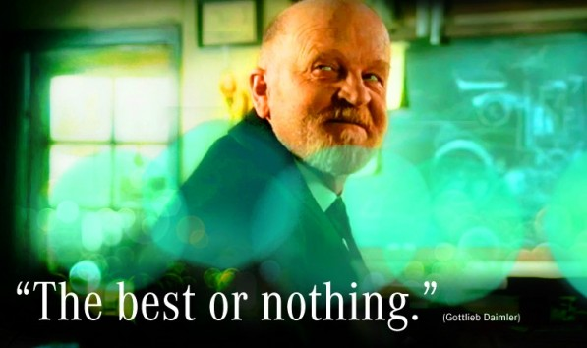
Mercedes Ad

Slide 15
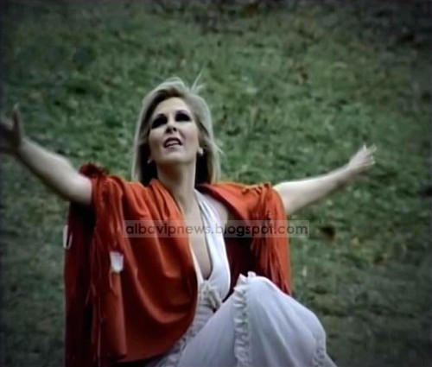

Slide 16
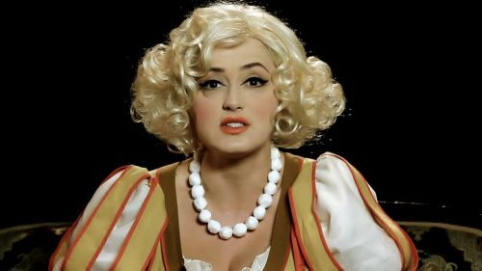

Slide 17
?

Slide 18
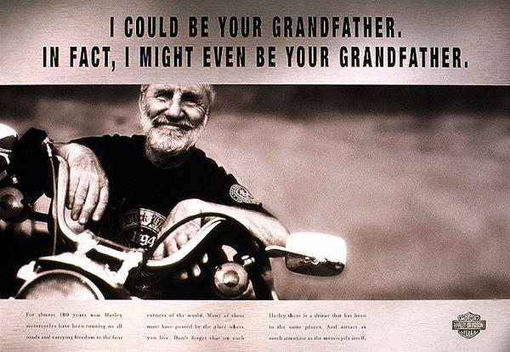
?

Slide 19
Global branding decisions
Brand form
FORMA e BRANDIT
Kvaliteti
Formulimi
Disajni
Variantat
Quality
Formulation
Design
Variants
KOMUNIKIMI I BRANDIT
Emri
Egzikutimi
Paketimi
SHTESAT e BRANDIT
Ofrimi/dergimi
Sherbimi
Grancionet
Global branding
Brand communications
Brand additions
Name
Execution
Packaging
Delivery
Service
Guarantees
D Jobber, Principles and Practice of Marketing, © 1998 McGraw-Hill
4

Slide 20
Brand name consideration
A good brand name should:
Evoke positive associations
Be easy to pronounce and remember
Suggest product benefits
Be distinctive
Use numerials when emphasizing technology
Not infringe an existing registered brand name
Një emër i mirë markës duhet të: 1. Nxit asocime pozitive
2.Të jetë i lehtë të ”shqiptohet” dhe te mbahet ne mend
3. Te “aludon” ne përfitimet e produktit
4. Të jetë i veçantë
5. Përdorimi numraves kur eshte e theksuar teknologjiasë
6. Nuk shkelë një emër ekzistues te regjistruar
Notes:
A good brand name should:
Evoke positive associations
Be easy to pronounce and remember
Suggest product benefits
Be distinctive
Use numerials when emphasizing technology
Not infringe an existing registered brand name

Slide 21
The product life cycle
Introduction
Paraqitja/hyrja
Growth
Rritja
Maturity
Pjekuria
Decline
Renia
Sales and profit
Sales
Profit
D Jobber, Principles and Practice of Marketing, © 1998 McGraw-Hill
9

Slide 22
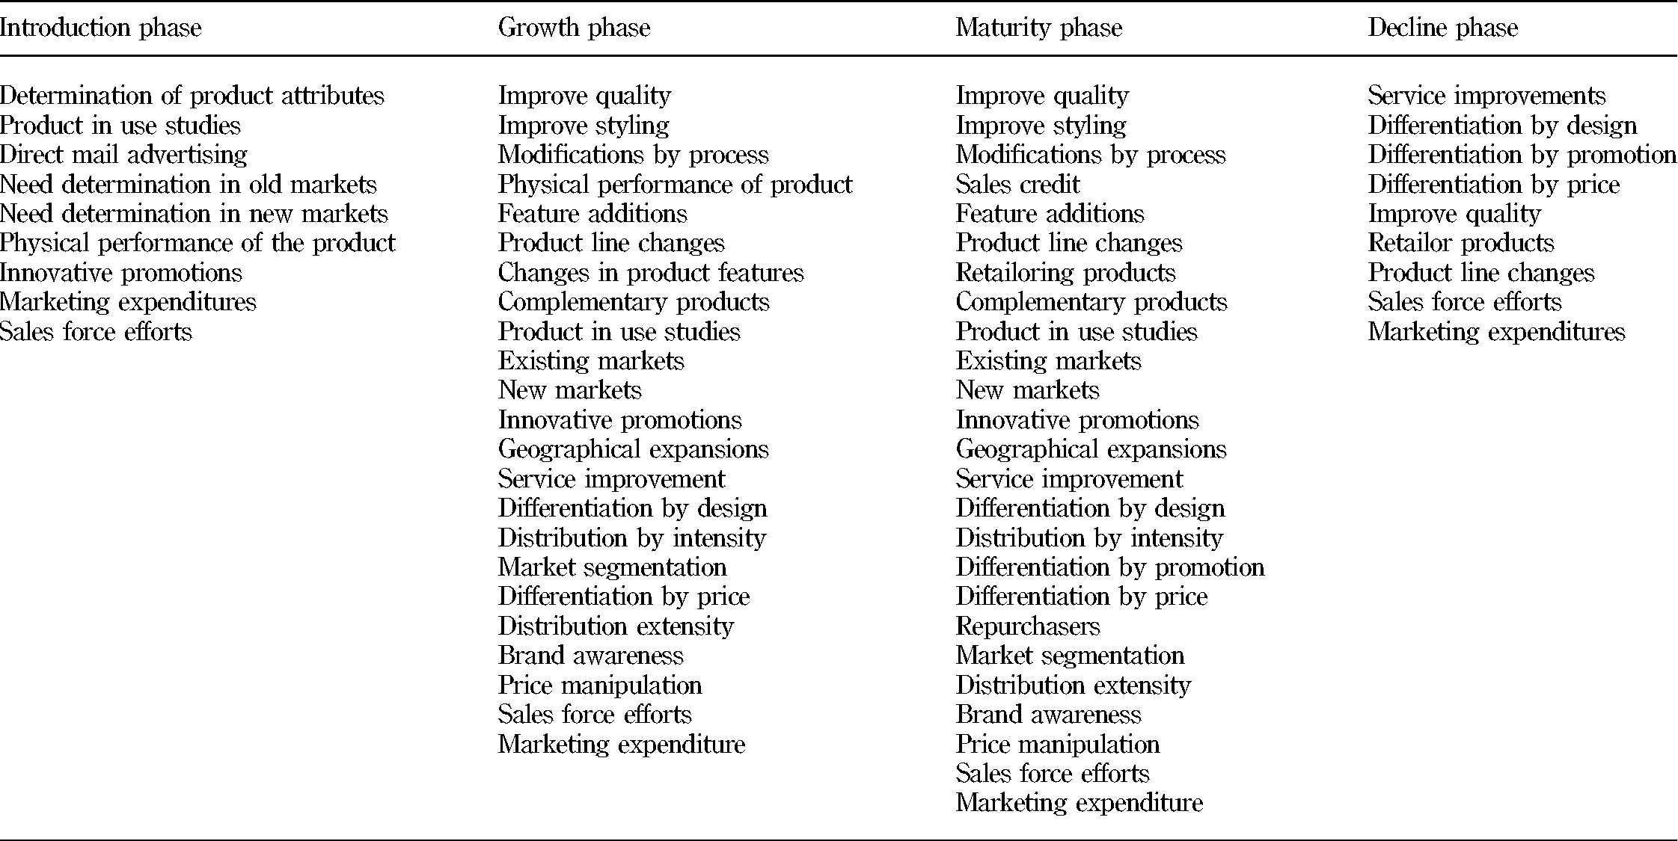
The product life cycle actions

Slide 23
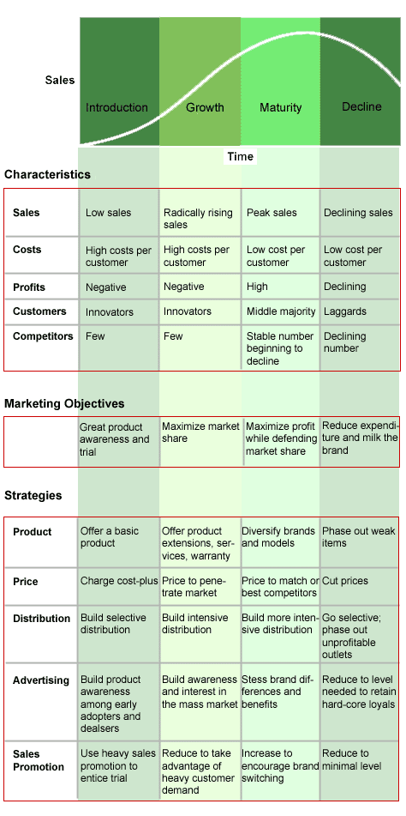

Slide 24
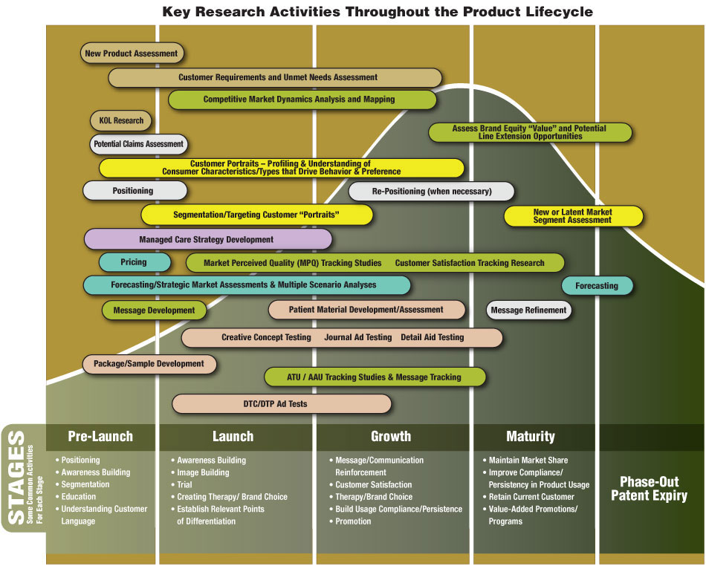

Slide 25
Key tasks in positioning
Market segmentation Segmentimi
2. Target market targetimi
Differentiated advantage Perparsia konkuruese
Positioning
Where and how we compete
Ku dhe Si do te konkurrojme
D Jobber, Principles and Practice of Marketing, © 1998 McGraw-Hill
10

Slide 26
Categories of New Products
New-To-The-World
E Re (sefte) per Boten
New Product Lines
Vijat e reja te produkteve
Six Categories
Of New Products
Kategorite e
produkteve te reja
Product Line Additions
Vijat shtese te produkteve
Improvements/Revisions
Permisimi/adaptime
Repositioned Products
Produkte te ripozicionuara
Lower-Priced Products
Produkte me qmime te ulta

Slide 27
Strategic objectives and the Boston Box

Slide 28
Strategic objectives and the Boston Box
Stars/Yjet
Problem children/ Femiju problematik
Build sales and/or market share / Krijo shitje dhe perqindje te tregut
Invest to maintain/increase leadership position Investo per te mbajtur pozicionin
Repel competitive challenges
Shfuqizo sfidat konkuruese
Build selectively/ Krijo ne menyre selektive
Focus on defendable niche where dominance can be achieved Fokusohu ne tregjet e “nishe” ku dominanca munde te arrihet
Harvest or divest the rest
“korr apo hjek pjese e mbetur”
Cash cows / Lopat e Keshit (liquiditetit
Hold sales and/or market share / Mbaje Shitjes dhe perqindjen
Defend position/ Mbroje pozicionin
Use excess cash to support stars, selected problem children and new product development
Shfrytezo liquiditetin per perkrahje te produkteve te reja
Dogs/Qente
Harvest /Korr or/apo
Divest/Hjeke or
Focus on defendable niche
Fokusohu ne mbrojtjen e Nishes ( tregut te vogel specifik)
D Jobber, Principles and Practice of Marketing, © 1998 McGraw-Hill
11

Slide 29
Strategic objectives and the Boston Box
Stars
Build sales and/or market share
Invest to maintain/increase leadership position
Repel competitive challenges
Problem children
Build selectively
Focus on defendable niche where dominance can be achieved
Harvest or divest the rest
Cash cows
Dogs
Hold sales and/or market share
Defend position
Use excess cash to support stars, selected problem children and new product development
Harvest or
Divest or
Focus on defendable niche
D Jobber, Principles and Practice of Marketing, © 1998 McGraw-Hill
12

Slide 30
Strategic objectives and the Boston Box
Problem children
Build selectively
Focus on defendable niche where dominance can be achieved
Harvest or divest the rest
Stars
Build sales and/or market share
Invest to maintain/increase leadership position
Repel competitive challenges
Cash cows
Dogs
Hold sales and/or market share
Defend position
Use excess cash to support stars, selected problem children and new product development
Harvest or
Divest or
Focus on defendable niche
D Jobber, Principles and Practice of Marketing, © 1998 McGraw-Hill
13

Slide 31
Strategic objectives and the Boston Box
Stars
Problem children
Build sales and/or market share
Invest to maintain/increase leadership position
Repel competitive challenges
Build selectively
Focus on defendable niche where dominance can be achieved
Harvest or divest the rest
Cash cows
Dogs
Hold sales and/or market share
Defend position
Use excess cash to support stars, selected problem children and new product development
Harvest or
Divest or
Focus on defendable niche
D Jobber, Principles and Practice of Marketing, © 1998 McGraw-Hill
14

Slide 32
Strategic objectives and the Boston Box
Stars
Problem children
Build sales and/or market share
Invest to maintain/increase leadership position
Repel competitive challenges
Build selectively
Focus on defendable niche where dominance can be achieved
Harvest or divest the rest
Cash cows
Hold sales and/or market share
Defend position
Use excess cash to support stars, selected problem children and new product development
Dogs
Harvest or
Divest or
Focus on defendable niche
D Jobber, Principles and Practice of Marketing, © 1998 McGraw-Hill
15

Slide 33
The case of an unbalanced portfolio
High
Market growth rate
Low
High
Low
Market share
D Jobber, Principles and Practice of Marketing, © 1998 McGraw-Hill
16

Slide 34
The General Electric Market Attractiveness–Competitive Position Model
1
High
3
Market attractiveness
Medium
2
4
Low
5
High
Medium
Low
Competitive strength
D Jobber, Principles and Practice of Marketing, © 1998 McGraw-Hill
17

Slide 35
Implications of portfolio planning Implikimet per planfikimin e portofolios
Different products
Different roles
Different reward systems
Different types of managers
D Jobber, Principles and Practice of Marketing, © 1998 McGraw-Hill
18

Slide 36
Product growth strategies: the Ansoff Matrix
Market penetration or expansion
Product development
Existing
Markets
New
Market development
Diversification
Existing
New
Products
D Jobber, Principles and Practice of Marketing, © 1998 McGraw-Hill
19

Slide 37
Strategic options for increasing sales volume
Increase sales volume
Rritja e e volumit shites
Penetrimi I tregut
Ekspansioni I tregut
Zhvillimi I produktit
Zhivilimi I tregut
Hyrje ne treg te ri
Market penetration
Market expansion
Product development
Market development
Entry into new markets
D Jobber, Principles and Practice of Marketing, © 1998 McGraw-Hill
20
Notes:
Rritja e e volumit shites
Penetrimi I tregut
Ekspansioni I tregut
Zhvillimi I produktit
Zhivilimi I tregut
Hyrje ne treg te ri

Slide 38
Strategic options for increasing sales volume
Increase sales volume
Market penetration
Win competitors’ customers
Market expansion
Buy competitors
Product development
Discourage competitive entry
Market development
Fito konsumatoret e konkurrences
Blej konkurrence
Dekurajoje hyrjen konkurruse
Entry into new markets
D Jobber, Principles and Practice of Marketing, © 1998 McGraw-Hill
21
Notes:
Fito konsumatoret e konkurrences
Blej konkurrence
Dekurajoje hyrjen konkurruse

Slide 39
Strategic options for increasing sales volume
Increase sales volume
Market penetration
Market expansion
Convert non-users
Product development
Increase usage rate
Market development
Konverto jo –perdoruesit
Rrite % e perdorimit
Entry into new markets
D Jobber, Principles and Practice of Marketing, © 1998 McGraw-Hill
22
Notes:
Konverto jo –perdoruesit
Rrite % e perdorimit

Slide 40
Strategic options for increasing sales volume
Increase sales volume
Zgjerimi I e vijes prodhuese
Zevendesimi I produktit
Innovacion
Market penetration
Market expansion
Product line extension
Product development
Product replacement
Market development
Innovation
Entry into new markets
D Jobber, Principles and Practice of Marketing, © 1998 McGraw-Hill
23
Notes:
Zgjerimi I e vijes prodhuese
Zevendesimi I produktit
Innovacion

Slide 41
Strategic options for increasing sales volume
Increase sales volume
Market penetration
Promovo perdorim te ri
Hyne ne segmente re reja
Market expansion
Product development
Promote new uses
Market development
Enter new segments
Entry into new markets
D Jobber, Principles and Practice of Marketing, © 1998 McGraw-Hill
24
Notes:
Promovo perdorim te ri
Hyne ne segmente re reja

Slide 42
Strategic options for increasing sales volume
Increase sales volume
Market penetration
Market expansion
Product development
Produkte re reja
Market development
Market development
Entry into new markets
New products
D Jobber, Principles and Practice of Marketing, © 1998 McGraw-Hill
25
Notes:
Produkte re reja

