Slide 1
Bazat e Marketingut
David Jobber
Chapter 7 Segmentimi dhe Pozicionimi në Marketing
Notes:
1
1

Slide 2
Objektivat Mesimore te kesaj ligjerate
1. Konceptet e segmentimit të tregut dhe marketingut të
synuar (target) dhe përdorimin e tyre në zhvillimin
e strategjisë së marketingut 2. Metodat e segmenting te konsumatoreve dhe tregjet
e organizative 3. Faktorët që mund të përdoren për të vlerësuar segmentet e
tregut 4. Katër strategji të tregut të synuar: padiferencuara, të
diferencuar, marketing i fokusuar dhe të përshtatur 5. Koncepti i pozicionimit(positioning) dhe çelësi
(metodat) për pozicionimin e sukseshem 6. Strategjite e Pozicionimit dhe ripozicionimit (respostionig)

Slide 3
Segmentimi I tregut
Teknikë që përdoret nga ”marketers” për konceptuar natyrën endryshme të tregjeve është quajtur segmentimii tregut . Segmentimi i tregut është përcaktuar si:
identifikimi i individëve apo organizatave me karakteristika të ngjashme që kanë implikime (pasoja) të rëndësishme për përcaktimin e strategjisë së marketingut

Slide 4
Tregu I Synuar ( targetuar)
Një Tregu i synuar është një segment i zgjedhur i tregut që një kompani ka vendosur për të shërbyer.
Pasi konsumatorët në segmentin e tregut të synuar kanë karakteristika të ngjashme, një strategji e vetme e marketingut mund të zhvillohen për t’ju pergjigjur atyre kërkesave.

Slide 5
Steps in Segmentation, Targeting, and Positioning
6. Develop Marketing
Mix for Each Target Segment
Market
Positioning
5. Develop Positioning
for Each Target Segment
4. Select Target
Segment(s)
Market
Targeting
3. Develop Measures
of Segment Attractiveness
2. Develop Profiles
of Resulting Segments
Market Segmentation
1. Identify Bases for segmenting
the Marketing
Notes:
Steps in Segmentation, Targeting, and Positioning
Market Segmentation. Market segmentation is the process of dividing a market into distinct groups of buyers who might require separate products or marketing mixes. All buyers have unique needs and wants. Still it is usually possible in consumer markets to identify relatively homogeneous portions or segments of the total market according to shared preferences, attitudes, or behaviors that distinguish them from the rest of the market. These segments may require different products and/or separate mixes.
Market Targeting. Market targeting is the process of evaluating each market segment's attractiveness and selecting one or more segments to enter. Given effective market segmentation, the firm must choose which markets to serve and how to serve them.
Discussion Note: In targeting markets to serve the firm must consider its resources and objectives in setting strategy.
Market Positioning. Market positioning is the process of formulating competitive positioning for a product and a detailed marketing mix. Marketers must plan how to present the product to the consumer.
Discussion Note: The product's position is defined by how consumers view it on important attributes.
Steps in Segmentation, Targeting, and Positioning
This CTR corresponds to Figure 7-1 on p. 196 and relates to the material on pp. 196.

Slide 6
Tregu

Slide 7
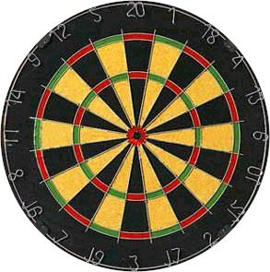
Tregu I segmentuar

Slide 8
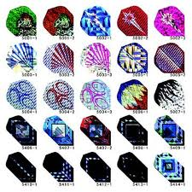
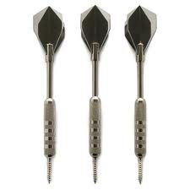
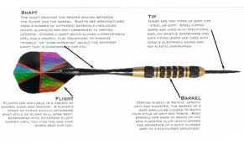
“Oferta”

Slide 9
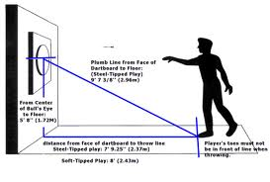
“Positioning”

Slide 10
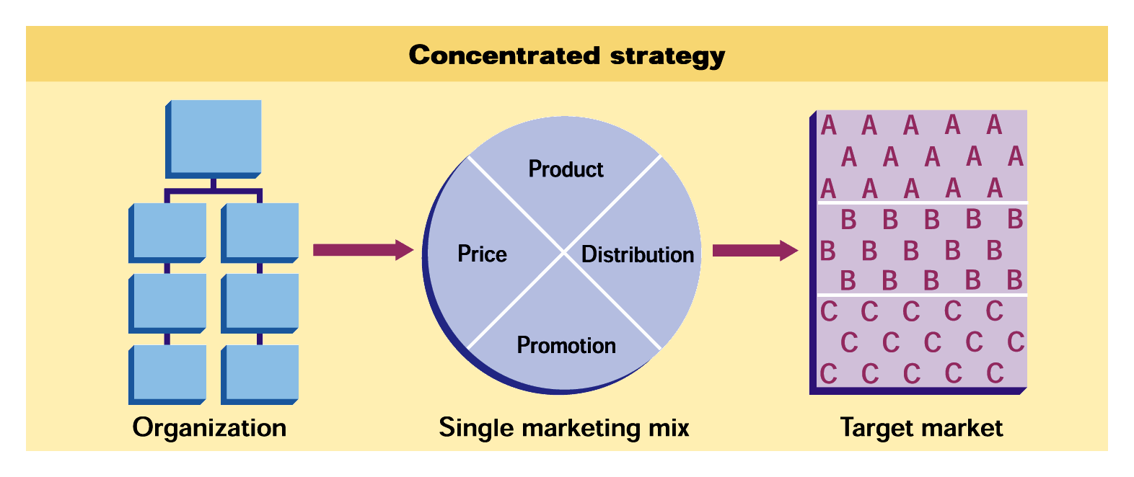
Concentrated Marketing
7P
FIGURE 7.2

Slide 11
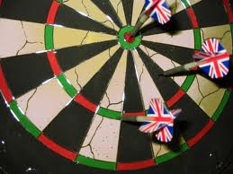
Segmenti I Synuar ( me ja qellu)

Slide 12
Target Market Selection Process
FIGURE 7.1

Slide 13
Avantazhet e Segmentimit të Tregut
Zgjedhja e Tregut të Synuar
Segmentimi i Tregut
Përshtatja e marketingut miks
Diferencimi
Shanset dhe Rreziqet
D Jobber, Principles and Practice of Marketing, © 1998 McGraw-Hill
2

Slide 14
Procesi i segmentimit të tregut dhe marketingu synues
Tregu i ndarë
Tregu i Segmentuar
Tregu i Synuar
c₁
1
2
3
1
2
3
c₃
c₂
c₁
c₃
c₁
c₃
c₄
c₆
c₅
c₂
c₄
c₅
c₂
Marketing mix targeted at segment 3
c₄
c₅
c₇
c₈
c₇
c₆
c₈
c₇
c₆
c₈
Këtu kuptohen karakteristikat e çdo konsumatori
Konsumatorët grupohen në segmente me të njëjtat preferenca
Segmenti 3 duket të jetë më atraktivi, dhe këtu formohet marketingu miks i përshtatur për këtë treg
D Jobber, Principles and Practice of Marketing, © 1998 McGraw-Hill
3

Slide 15
Market Segmentation Bases for Segmenting Consumer Markets ( Baza per segmentimin e Konsumatoreve
Geographic
Nations, states,
regions or cities
Demographic
Age, gender, family size and life cycle, or income
Psychographic
Social class, lifestyle, or personality
Behavioral
Occasions, benefits, uses, or responses
Notes:
Market Segmentation
This CTR relates to Table 7-1 on p. 203 and the material on pp. 202-209.
Bases for Segmenting Consumer Markets
Geographic Segmentation. Geographic segmentation divides the market into different geographic units based upon physical proximity. While location determines how geographic segmentation is done, it is also true that many consumer products have attribute differences associated with regional tastes.
Demographic Segmentation. Dividing the market into groups based upon variables such as sex, age, family size, family life cycle, income, education, occupation, religious affiliation, or nationality are all demographic segmentations. Consumer needs often vary with demographic variables. Demographic information is also relatively easy to measure. Age and life-cycle stage, sex, and income are three major demographic bases for segmentation.
Psychographic Segmentation. Psychographic Segmentation divides the market into groups based on social class, life style, or personality characteristics. Psychographic segmentation cuts across demographic differences. Social class preferences reflect values and preferences that remain constant even as income increases. Life style describes helps group markets around ideas such as health, youthful, or environmentally conscious. Personalities may transcend other differences in markets and may be transferred to products themselves.
Behavioral Segmentation. Behavioral Segmentation divides markets into groups based on their knowledge, attitudes, uses, or responses to a product. Types of of behavioral segmentation are based upon occasions, benefits sought, user status, usage rates, loyalty, buyer readiness stage, and attitude.

Slide 16
Segmentimi i tregjeve konsumatore
Segmentimi i Konsumatorëve
Sjelljet
Psikografia
Profili
Benefitet e pritura
Stili i jetës
Demografia
Rasti i blerjes
Personaliteti
Socio-ekonomia
Sjelljet blerëse
Gjeografia
Përdorimi
Përceptimet dhe besimet
D Jobber, Principles and Practice of Marketing, © 1998 McGraw-Hill
4

Slide 17
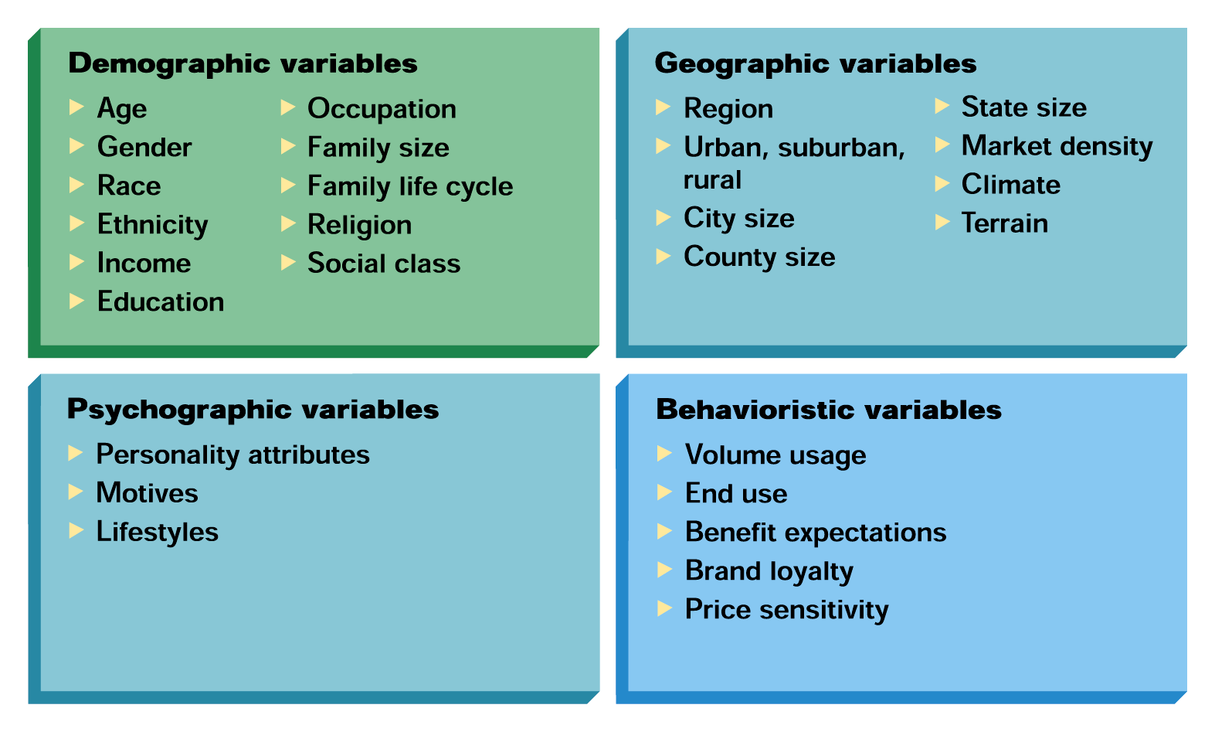
The Classic Segmentation Variables for Consumer Markets
FIGURE 7.3

Slide 18
Makro dhe Mikro Segmentimet e Tregjeve
Tregu Organizativ
Makrosegmenti 1 (kompanitë e mëdha)
Makrosegmenti 2 (kompanitë e mesme)
Makrosegmenti 3 (kompanitë e vogla)
Makrosegmenti 1 (Kriteri kryesor zgjedhor: besueshmëri)
Makrosegmenti 2 (Kriteri kryesor zgjedhor : lehtësia)
Makrosegmenti 3 (Kriteri kryesor zgjedhor : çmimi)
D Jobber, Principles and Practice of Marketing, © 1998 McGraw-Hill
5

Slide 19
Market Targeting Evaluating Market Segments- Evaluimi I Segmenteve te tregut
Segment Size and Growth
Analyze sales, growth rates and expected profitability.
Analizo Shitjen, Shkallen e rritjes, dhe profitin e parashikuar
aility.
Segment Structural Attractiveness
Consider effects of: Competitors, Availability of Substitute Products and, the Power of Buyers & Suppliers.
Konsidero efektet e Konkurrences, oferta e produkteve “zevendesuse” , fuqine e blersave dhe furnizuesve
Company Objectives and Resources
Company skills & resources relative to the segment(s).
Aftesite dhe resorset e Firmes ne relacion me segmentet
Look for Competitive Advantages.
Shiko per perparesine konkurruese
Notes:
Evaluating Market Segments
Segment Size and Growth. The company must collect and analyze data on current dollar sales, projected sales-growth, and expected profit margins for each market segment.
Segment Structural Attractiveness. Long run attractiveness includes an assessment of current and potential competitors, the threats of substitutes, and the power of buyers and suppliers.
Company Objectives and Resources. The company’s resources and core business strengths should also fit well with the market segment opportunities.
Evaluating Market Segments
This CTR relates to the material on pp. 215-216.

Slide 20
Market Segmentation Bases for Segmenting Business Markets – Baza per segmetimin e tregut te organizatave
Personal
Characteristics
Demographics
Bases
for Segmenting
Business
Markets
Situational
Factors
Operating
Characteristics
Purchasing
Approaches
Notes:
Segmenting Business Markets
This CTR corresponds to Table 7-3 on p. 213 relates to the material on pp. 212.
Major Segmentation Variables for Business Markets
Demographics. Industry segmentation focuses on which industries buy the product. Company size can be used. Geographic location may be used to group businesses by proximity.
Operating Variables. Business markets can be segmented by technology (what customer technologies should we focus on?), user/nonuser status (heavy, medium, light), or customer capabilities (those needing many or few services).
Purchasing Approaches. Five approaches are possible. Segmentation can be by purchasing function organization (centralized or decentralized), power structure (selecting companies controlled by a functional specialty), the nature of existing relationships (current desirable customers or new desirable customers), general purchase policies (focus on companies that prefer some arrangements over others such as leasing, related support service contracts, sealed bids), or purchasing criteria (focus on noncompensatory criteria such as price, service, or quality).
Situational Factors. Situational segmentation may be based upon urgency (such as quick delivery needs), specific application (specific uses for the product) or size of order (few large or many small accounts).
Personal Characteristics. Personal comparisons can lead to segmentation by buyer-seller similarity (companies with similar personnel and values), attitudes toward risk (focus on risk-taking or risk-avoiding companies), or loyalty (focus on companies that show high loyalty to their suppliers.

Slide 21
Market Segmentation Bases for Segmenting International Markets- Bazat per segmentim internacional te tregut
Industrial Markets
Geographic
Economic
Political/
Legal
Cultural
Intermarket
Notes:
Segmenting International Markets
This CTR relates to the discussion on pp. 213-215.
Segmenting International Markets
Geographic Segmentation. This works well when proximity is the critical segmentation variable.
Economic Factors. Countries might be grouped by population income levels or by overall level of economic development.
Political and Legal Factors. Segmentation may be most appropriate in terms of the level of government stability, monetary regulations, receptivity to foreign firms, or the amount of bureaucracy encountered when conducting business.
Cultural Factors. Segmentation by common language, religion, or values might be the best way to proceed.
Intermarket Segmentation. This involves forming segments of consumer who have similar needs and buying behavior even though they are located in different countries.

Slide 22
Market Segmentation Requirements for Effective Segmentation –”kushtet” per Segmentim efektiv
Measurable-
Te matshem
Accessible –
(te kemi) Qasje
Substantial-
( madhesine e mjaftushme)
Size, purchasing power, profiles
of segments can be measured.
Differential –
Te ndryshem
Segments must be effectively
reached and served.
Actionable
Inicues, Akcione,
Segments must be large or profitable enough to serve.
Segments must respond differently to different marketing mix elements & actions.
Must be able to attract and serve the segments.
Notes:
Effective Segmentation
This CTR relates to the material on pp. 215.
Requirements for Effective Segmentation
Measurability . This refers to the degree to which the size and purchasing power of the segments can be measured. The accuracy and availability of measures of market potential are important.
Accessibility. This refers to the degree to which a market segment can be reached and served. Identifying a segment is useless if the marketer has limited access to the customer.
Substantiality. This refers to the degree to which the segments are large or profitable enough to service.
Actionability. This is the degree to which an effective marketing program can be designed for attracting and serving segments. Company resource limitations figure prominently in actionability issues.

Slide 23
Segmentimi i Tregjeve Organizative
Segmentimi Organizativ
Makrosegmentimi
Mikrosegmentimi
Zgjedhja
Madhësia organizative
Struktura e njësisë vendimmarrëse
Industria
Procesi i vendimmarrjes
Lokacioni gjeografik
Lloji i blerjes
Organizata që blen
Inovacionet organizative
D Jobber, Principles and Practice of Marketing, © 1998 McGraw-Hill
6

Slide 24
Market Segmentation Levels of Market Segmentation
Mass Marketing
Same product to all consumers
(no segmentation)
Segment Marketing
Different products to one or more segments
(some segmentation)
Niche Marketing
Different products to subgroups within segments
( more segmentation)
Micromarketing
Products to suit the tastes of individuals or locations
(complete segmentation)
Notes:
Stages in Market Orientation
This CTR relates to the discussion on pp. 197-202.
Stages in Market Orientation
Sellers traditionally have passed through three stages of orientation or philosophy of identifying markets that lead to greater use of segmentation, targeting, and positioning strategies:
Mass Marketing. In mass marketing, the seller produces, mass distributes, and mass promotes one product to all buyers. The argument for mass marketing is that it [should] lead to the lowest costs (through economies of scale) and prices and create the largest potential market.
Segment Marketing. Here the seller identifies market segments, selects one or more of them, and develops products and marketing mixes tailored to meeting the needs of those selected segments. As more competitors adopt this practice, fragmentation of the market leads to
Niche Marketing. Here the seller focuses on subgroups within market segments who may seek a special combination of benefits.
Micromarketing. This is the practice of tailoring products and marketing programs to suit the tastes of specific individuals and locations.

Slide 25
Strategjitë e marketingut të synuar
Marketingu i padiferencuar
Marketingu i diferencuar
Marketingu i fokusuar
Marketingu i përshtatur
D Jobber, Principles and Practice of Marketing, © 1998 McGraw-Hill
7

Slide 26
Strategjitë e marketingut të synuar
Marketingu i padiferencuar
Marketingu Miks
Marketingu i tërë
D Jobber, Principles and Practice of Marketing, © 1998 McGraw-Hill
8

Slide 27
Strategjitë e marketingut të synuar
Marketingu i diferencuar
Marketingu miks1
Segmenti 1
Marketingu miks 2
Segmenti 2
Marketingu miks 3
Segmenti 3
D Jobber, Principles and Practice of Marketing, © 1998 McGraw-Hill
9

Slide 28
Strategjitë e marketingut të synuar
Marketingu i fokusuar
Segmenti 1
Segmenti 2
Marketingu miks
Segmenti 3
D Jobber, Principles and Practice of Marketing, © 1998 McGraw-Hill
10

Slide 29
Strategjitë e marketingut të synuar
Marketingu i përshtatur
Marketingu miks1
Konsumatori 1
Marketingu miks 2
Konsumatori 2
Marketingu miks 3
Konsumatori 3
D Jobber, Principles and Practice of Marketing, © 1998 McGraw-Hill
11

Slide 30
Step 2. Market Targeting Market Coverage Strategies
Company
Marketing
Mix
Market
Company
Marketing Mix 1
Segment 1
Company
Marketing Mix 2
Segment 2
A. Undifferentiated Marketing
Company
Marketing Mix 3
Segment 3
Segment 1
Company
Marketing
Mix
Segment 2
B. Differentiated Marketing
Segment 3
C. Concentrated Marketing
Notes:
Market Coverage Strategies
This CTR corresponds to Figure 7-4 on p. 217 and relates to the discussion on pp. 216-219.
Market Coverage Strategies
Undifferentiated Marketing. This strategy uses the same marketing mix for the entire market. This strategy focuses on the common needs of the market rather than differences in it. Undifferentiated marketing provides economies of scale on product costs but may be limited in application.
Differentiated Marketing. This strategy targets several market segments and designs separate marketing mixes for each of them. Product and marketing variation also helps company image and may produce loyalty in consumers as they change segments.
Concentrated Marketing. This strategy commits a company to pursue a large share of one or more submarkets. Economies and segment knowledge and service are strengths of this approach but risk due to smaller market size is greater.

Slide 31
Pozicionimi i suksesshëm
Kthjelltësia
Përputhshmëria
Pozicionimi i suksesshëm
Besueshmëria
Konkurrueshmëria
D Jobber, Principles and Practice of Marketing, © 1998 McGraw-Hill
12

Slide 32
Hartë perceptuale e supermarketeve
Cmimi i lartë
A
B
C
D
Gama e gjerë e produkteve
Gama e ngushtë e produkteve
G
X
F
E
Cmimi i ultë
D Jobber, Principles and Practice of Marketing, © 1998 McGraw-Hill
13

Slide 33
Rivendosja e Strategjive
Produkti
Njëjtë
Tjetër
Ripozicionimi i Imazhit
Ripozicionimi i Produktit
Njëjtë
Tregu i Synuar
Ripozicionimi i Pakapshëm
Ripozicionimi i Kapshëm
Tjetër
D Jobber, Principles and Practice of Marketing, © 1998 McGraw-Hill
14

